Slide 1
Findings from NCHRP 08-110
Traffic Forecasting Accuracy Assessment Research
March 15, 2019
Dave Schmitt
Connetics Transportation Group
Jawad Hoque
University of Kentucky
Elizabeth Sall
UrbanLabs

Slide 2
“The greatest knowledge gap in US travel demand modeling is the unknown accuracy of US urban road traffic forecasts.”
Hartgen, David T. “Hubris or Humility? Accuracy Issues for the next 50 Years of Travel Demand Modeling.” Transportation 40, no. 6 (2013): 1133–57.
Notes:
Dave to start off introducing the project after presenting his Transit Research.

Slide 3
Project Objectives
“The objective of this study is to develop a process to analyze and improve the accuracy, reliability, and utility of project-level traffic forecasts.”
-- NCHRP 08-110 RFP
Accuracy is how well the forecast estimates project outcomes.
Reliability is the likelihood that someone repeating the forecast will get the same result.
Utility is the degree to which the forecast informs a decision.
Notes:
Dave

Slide 4
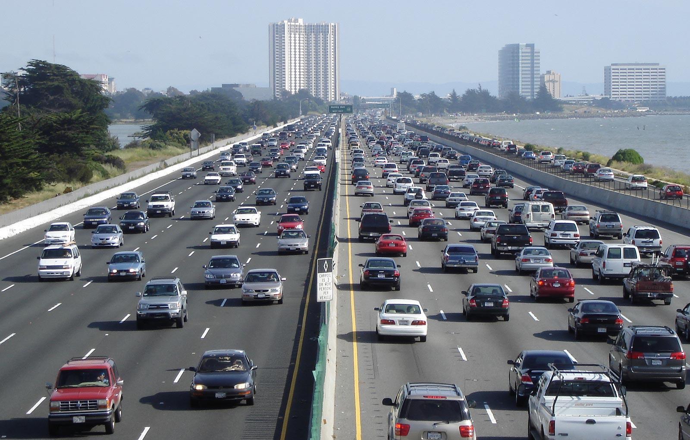
1. Research Approach

Slide 5
Research Question and Approach
Method: Statistical analysis of actual vs forecast traffic for a large sample of projects after they open.
Method: "Deep dives" into forecasts of six substantial projects after they open.
Output: Estimated effect of known errors, and remaining unknown error.
Question: How can we improve forecasting practice?
Method: Derive lessons from this research and review with practitioners.
Output: Recommendations for how to learn from past traffic forecasts.
Question: How accurate are traffic forecasts?
Question: What are the sources of forecast error?
Output: Distribution of expected traffic volume as a function of forecast volume.

Slide 6
Challenges
“The lack of availability for necessary data items is a general problem and probably the biggest limitation to advances in the field.”
Nicolaisen and Driscoll, 2014
Forecast Accuracy Database:
Project, forecast and actual traffic information.
2611 unique projects
Case Studies:
5 projects with model runs
Large-N Analysis
Deep Dives

Slide 7
2. Large-N Analysis
Notes:
Jawad to start from here.

Slide 8
Forecast Accuracy Database
6 states: FL, MA, MI, MN, OH, WI + 4 European nations: DK, NO, SE, UK
Total: 2,600 projects, 16,000 segments
Open with Counts: 1,300 projects, 3,900 segments
Notes:
In total we had this many projects with this many segments. But we also had a lot of missing data, since each agency had two-thirds of the items filled, but not the same two-thirds everytime.

Slide 9
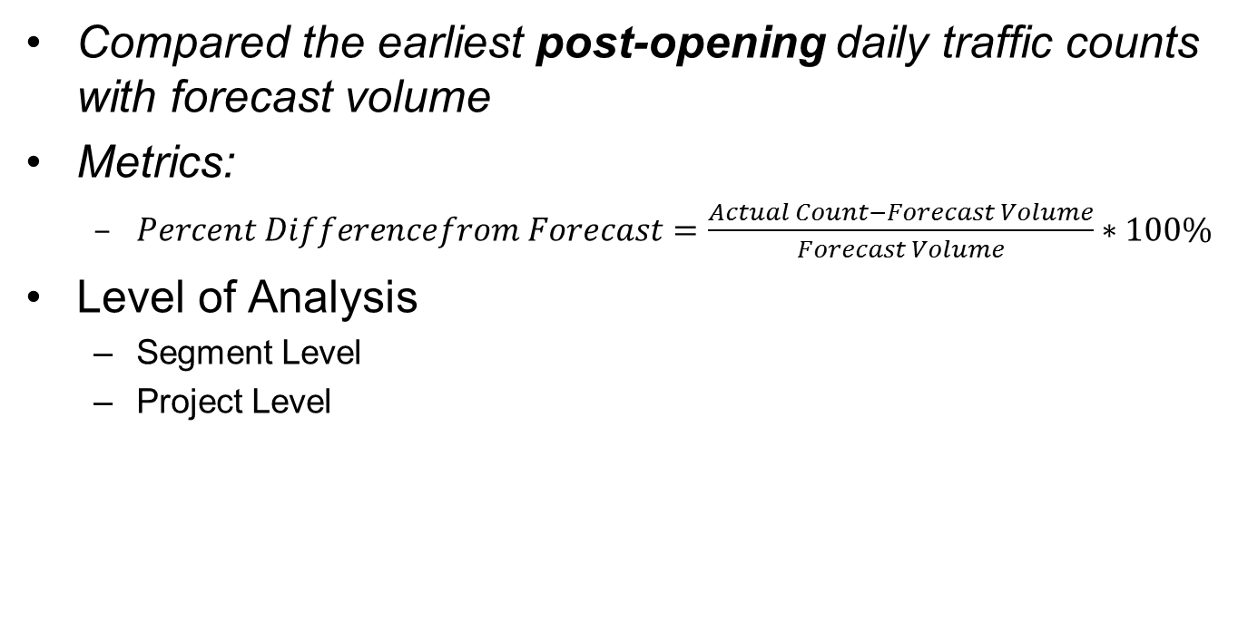
Large N Analysis
About the Methodology
Compared the earliest post-opening daily traffic counts with forecast volume
Metrics:
  $\begin{aligned}Percent Differencefrom Forecast=\frac{Actual Count−Forecast Volume}{Forecast Volume}∗100\%\end{aligned}$
Level of Analysis
  Segment Level
  Project Level
Notes:
Our Large-N methodology is calculating the Percent Difference or PDF. Positive value means under prediction, negative means over prediction. Won’t spend too much time explaining each level of analysis. Will discuss on the next slide.

Slide 10
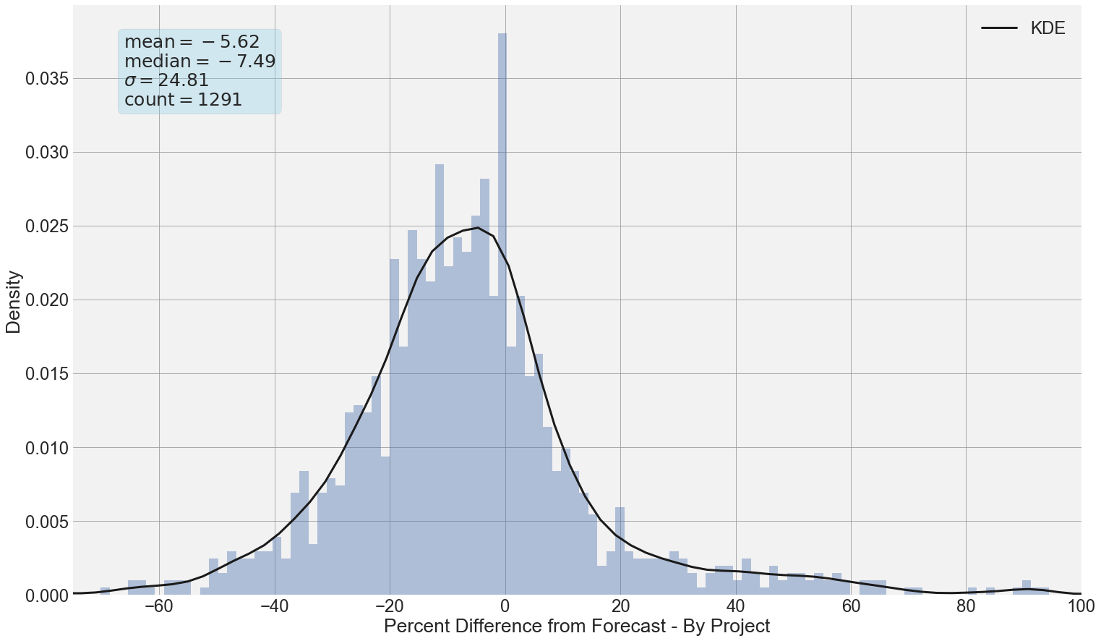

How Accurate Are Traffic Forecasts?
$${PDFF}_{i}=\frac{\left(Actual−Forecast\right)}{Forecast}∗100$$
On average, the actual traffic volume is about 6% lower than forecast.
On average, the actual traffic is about 17% different from forecast.

Slide 11
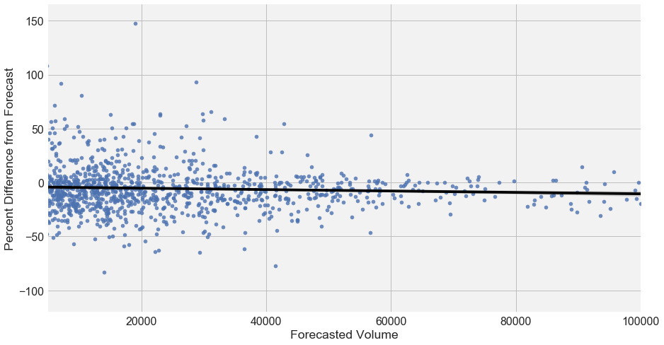

How Accurate Are Traffic Forecasts?
$${PDFF}_{i}=\frac{\left(Actual−Forecast\right)}{Forecast}∗100$$
Traffic forecasts are more accurate, in percentage terms, for higher volume roads.
95% of forecasts reviewed are “accurate to within half of a lane.”

Slide 12
Large N Results
Traffic forecasts are more accurate for:
Higher volume roads
Higher functional classes
Shorter time horizons
Travel models over traffic count trends
Opening years with unemployment rates close to the forecast year
More recent opening & forecast years

Slide 13
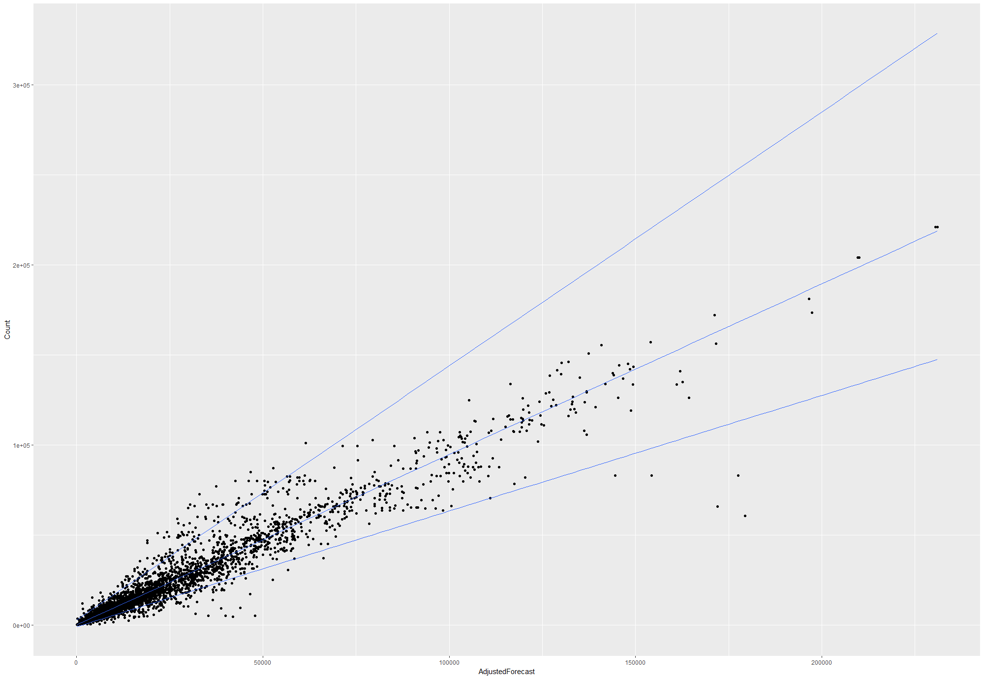
Estimating Uncertainty
Our research provides a means of estimating the range of uncertainty around a forecast using quantile regression.
Actual ADT
Draw lines so 95% of dots are between the lines
Forecast ADT
Notes:
Possibly Jawad, can also be Elizabeth.
One other thing we tried with our analysis is creating an uncertainty window. If we could draw lines around this dot diagram which will have 95% of them inside, it can represent the undertainty.

Slide 14



Estimating Uncertainty
To draw a line through the middle of the cloud, we use regression.
To draw a line along the edge of the cloud, we use quantile regression. It’s the same thing, but for a specific percentile instead of the mean.
$$A_{95th} =2940+1.42F+ε$$
$$A_{50th}= 37+0.94F+ε$$
$$A_{5th} =−826+0.62F+ε$$

Slide 15
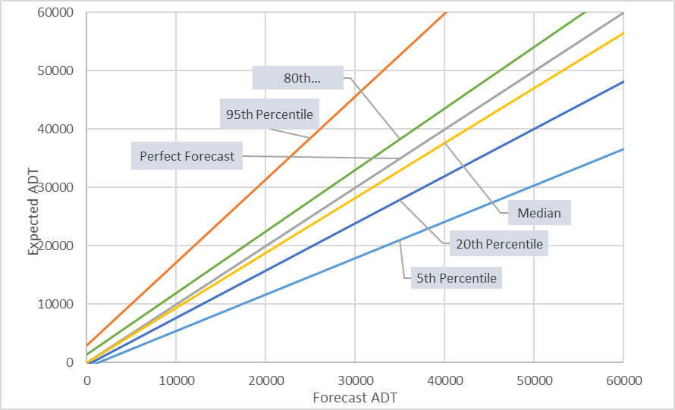
Quantile Regression Output
46,000
18,000
Notes:
Example. If we have a forecast of 30k on a certain type of roadway with certain characteristics, historically the 95% actual traffic has been between 18k to 45k.

Slide 16
3. Deep Dive Results
Notes:
Jawad

Slide 17
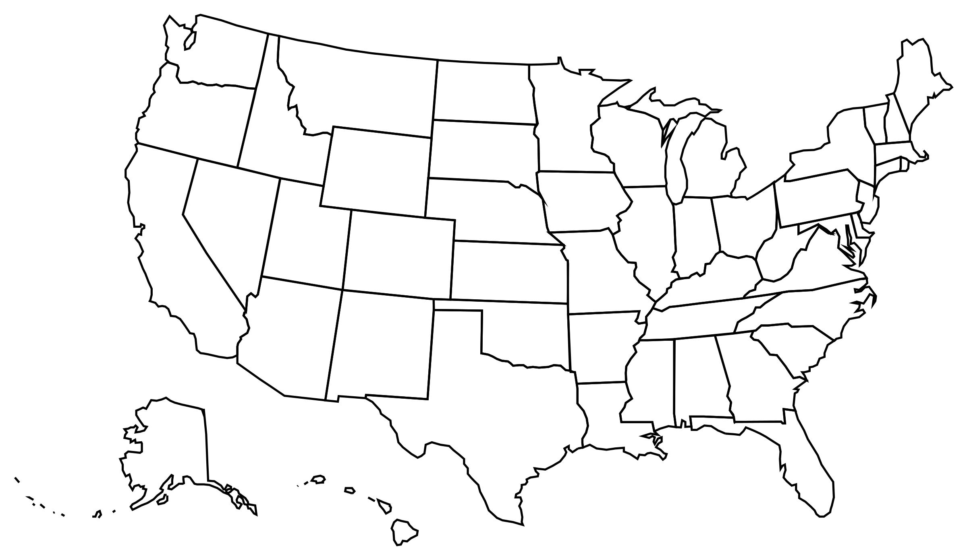
Deep Dives
Projects selected for Deep Dives
Eastown Road Extension Project, Lima, Ohio
Indian River Street Bridge Project, Palm City, Florida
Central Artery Tunnel, Boston, Massachusetts
Cynthiana Bypass, Cynthiana, Kentucky
South Bay Expressway, San Diego, California
US-41 (later renamed I-41), Brown County, Wisconsin

Slide 18
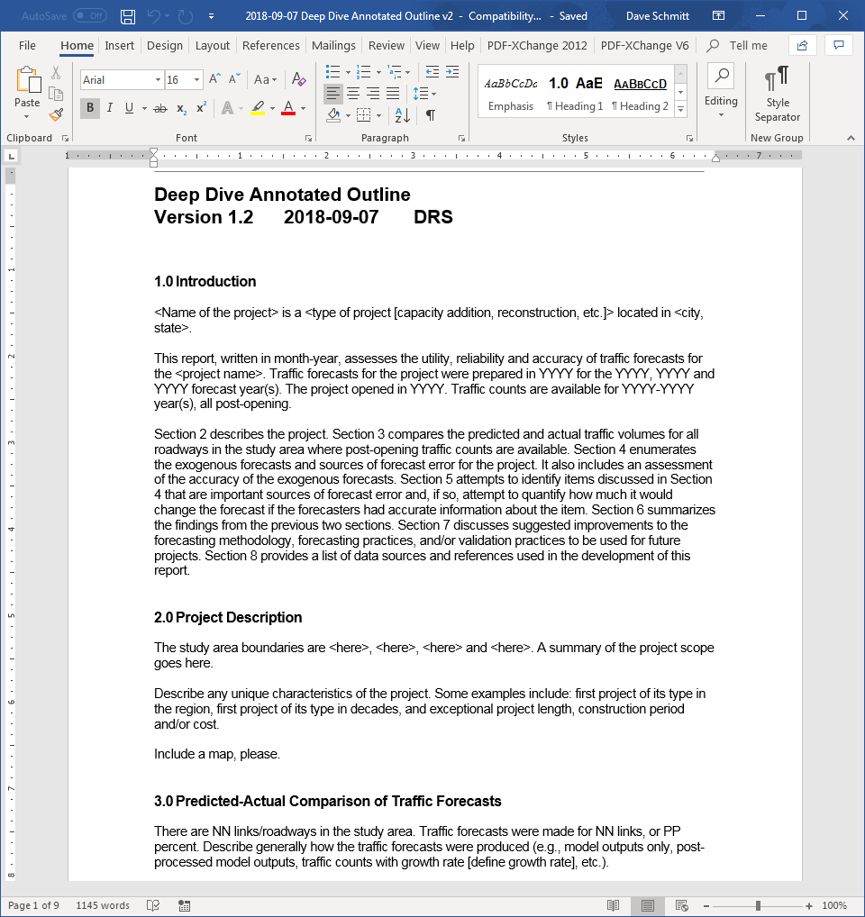
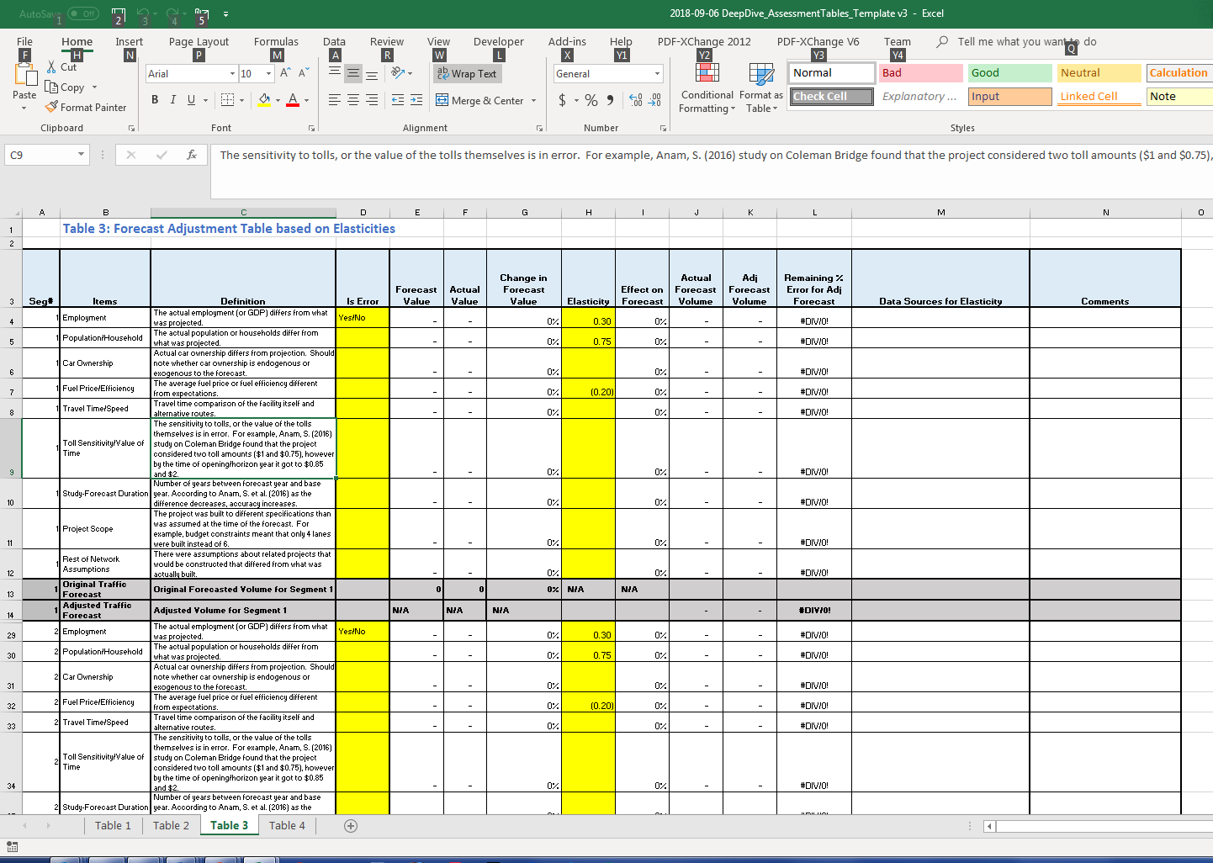
Deep Dive Methodology
Collect data:
  Public Documents
  Project Specific Documents
  Model Runs
Investigate sources of errors as cited in previous research:
  Employment, Population projections etc.
Adjust forecasts by elasticity analysis
Run the model with updated information

Slide 19
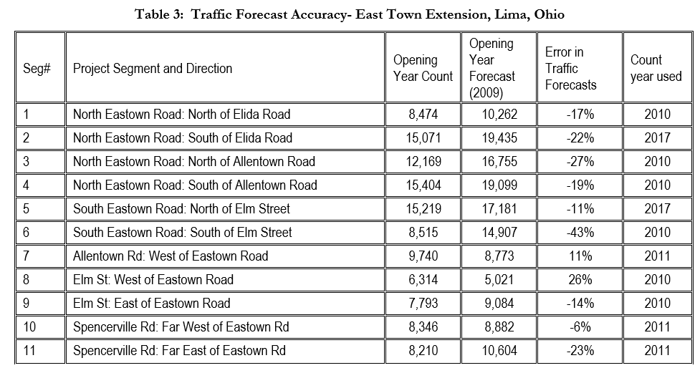
Step 1: Document forecast & actual volumes by segment
Notes:
Transition quickly here.

Slide 20
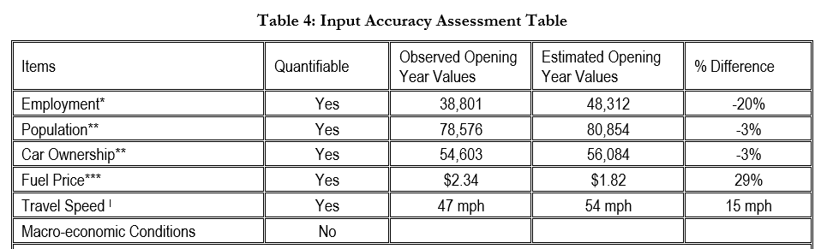
Step 2: Document forecast & actual values of inputs

Slide 21
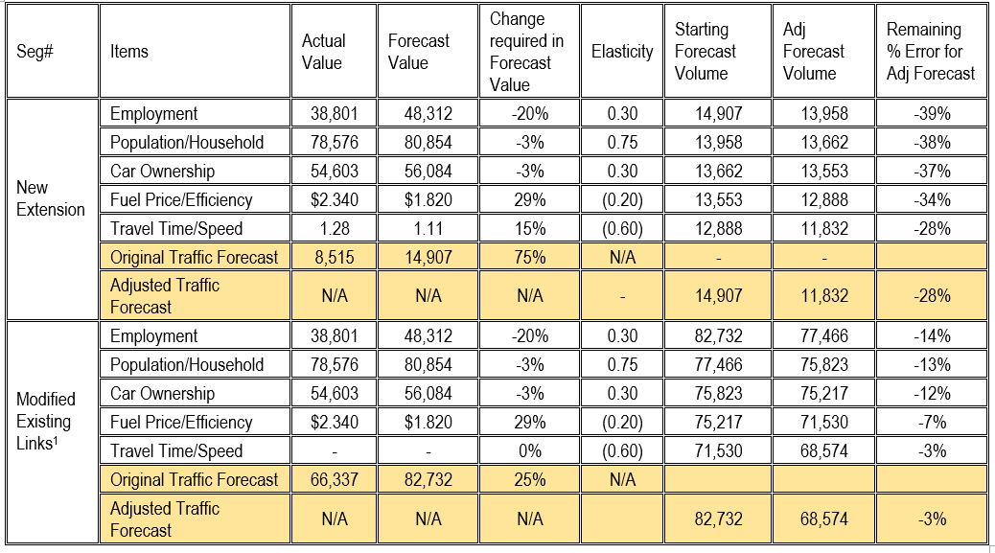
Step 3: Re-run models with corrected inputs or use elasticities to adjust
Notes:
Slides 19,20 and 21 are basically rehash of the methodology. So don’t need to spend time on it.

Slide 22
Deep Dives
Eastown Road Expansion Project
  Employment, population, car ownership, fuel price, travel time are the identified sources of error.
  Correcting input errors improved forecasts significantly.
Indian River Bridge Project
  Base year validation was reasonable, but still an error of 60%
  Very slight improvement after accounting for input errors (employment, population and fuel price)
Notes:
Will not linger here for too much.

Slide 23
Deep Dives
Central Artery/Tunnel Project
  Accurate forecasts for a massive project with a long horizon, originally off by only 4% on existing links and 16% on new links.
  Slight improvement in accuracy after correcting for input errors (employment, population and fuel price)
Cynthiana Bypass Project
  External traffic projections (43% lower than forecast) major contributing factor
  Correcting for external traffic projections reduced error significantly

Slide 24
Deep Dives
Southbay Expressway Project (toll road)
  Contributing factors identified as recession just after opening, decrease in border crossing traffic and increase in toll.
Interstate 41 Project
  Accuracy improved after correcting exogenous population forecast.
  Relative lack of forecast documentation and unavailability of archived model

Slide 25
Deep Dive Results
Project | Original Percent Difference from Forecast | Remaining percent difference from forecast after adjusting for errors in: |  | Remaining percent difference from forecast after all adjustments
Eastown Road Extension Project, Lima, Ohio | -43% | Employment | -39% | -28%
 |  | Population/Household | -38%
 |  | Car Ownership | -37%
 |  | Fuel Price/Efficiency | -34%
 |  | Travel Time/Speed | -28%
Indian River Bridge, Palm City, Florida | -60% | Employment | -59% | -56%
 |  | Population | -61%
 |  | Fuel Price | -56%
Central Artery Tunnel, Boston, Massachusetts | -16% | Employment | -10% | -10%
 |  | Population | -14%
 |  | Fuel Price | -10%
Cynthiana Bypass, Cynthiana, Kentucky | -27% | Employment | -25% | -8%
 |  | Population | -25%
 |  | External Trips Only | 7%
US 41 (later renamed as I-41), Brown County, Wisconsin | -5% | Population | -4% | -6%
 |  | Fuel Price | -6%
Southbay Expressway, San Diego, California | Revenue less than projected, leading to bankruptcy of P3. | Socio Economic Growth | The available documentation did not allow the effect of these factors on traffic volume to be quantified.
 |  | Border crossing
 |  | Toll rates

Slide 26
Deep Dives
General Conclusions
The reasons for forecast inaccuracy are diverse.
Employment, population and fuel price forecasts often contribute to forecast inaccuracy.
External traffic and travel speed assumptions also affect traffic forecasts.
Better archiving of models, better forecast documentation, and better validation are needed.

Slide 27
4. Recommendations
Notes:
Spend about 5 minutes on this section.

Slide 28
1. Use a range of forecasts to communicate uncertainty
Report a range of forecasts.
Quantile regression
If the project were at the low/high end of the forecast range, would it change the decision?

Slide 29
2. Archive your forecasts
Bronze: Record basic forecast and actual traffic information in a database
Silver: Bronze + document forecast in a semi-standardized report
Gold: Silver + make the forecast reproducible

Slide 30
3. Periodically Report the Accuracy
Provides empirical information on uncertainty.
Ensures a degree of accountability and transparency

Slide 31
4. Use Past Results to improve forecasting method
Evaluate past forecasts to learn about weaknesses of existing model
  Identify needed improvements
Test the ability of the new model to predict those project-level changes
  Do the improvements help?
Estimate local quantile regression models
  Is my range narrower than my peer’s?
We build models to predict change. We should evaluate them on their ability to do so.

Slide 32
Why?
Giving a range → more likely to be “right”
Archiving forecasts and data → Provides evidence for effectiveness of tools used
Data to improve models → Testing predictions is the foundation of science
Together, the goal is not only to improve forecasts, but to build credibility.

Slide 33
5. Archive and Information System
Notes:
Elizabeth to start here.

Slide 34
Archive & Information System
Desired features:
Stable, long-term archiving
Ability to add reports or model files
Enable multiple users and data sharing
Private/local option
Mainstream and low-cost software
Standard data fields!

Slide 35
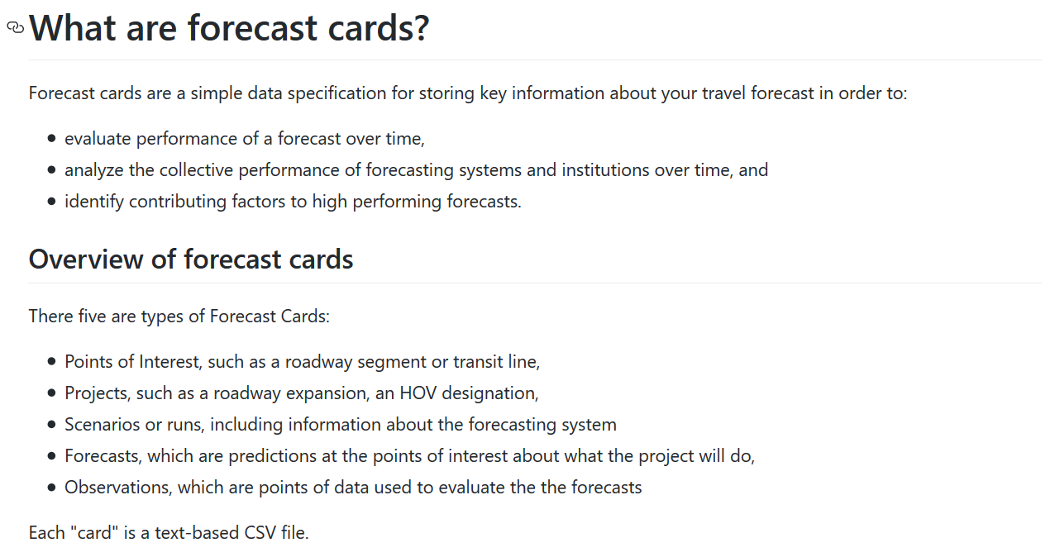
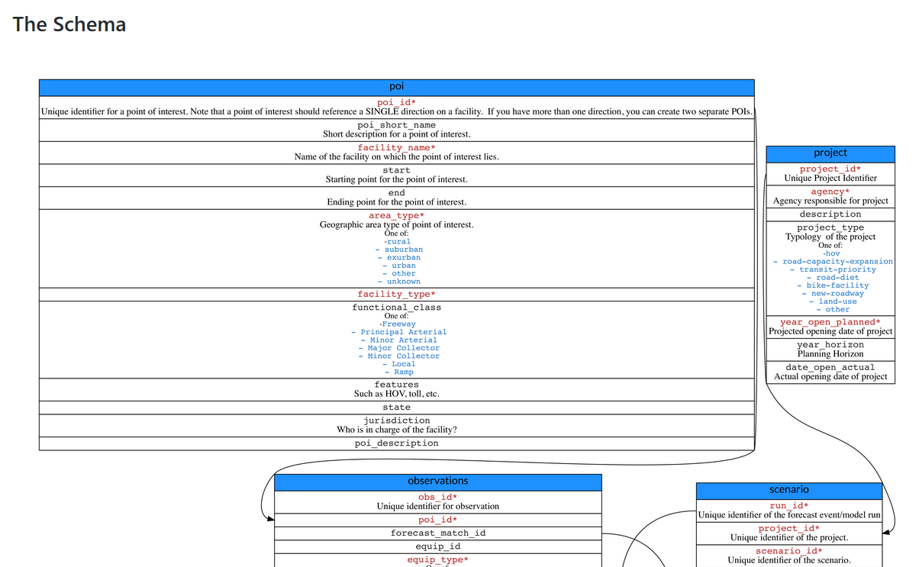
forecastcards
https://github.com/e-lo/forecastcards

Slide 36
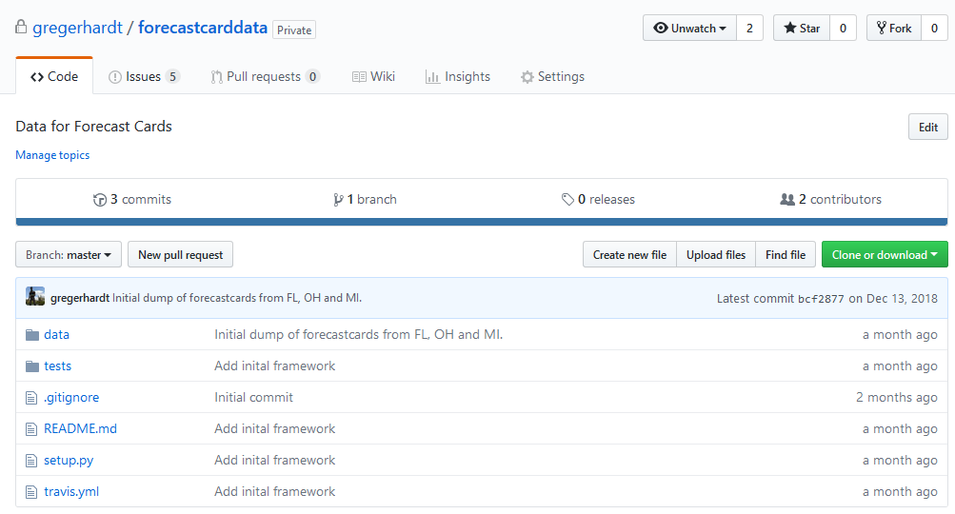
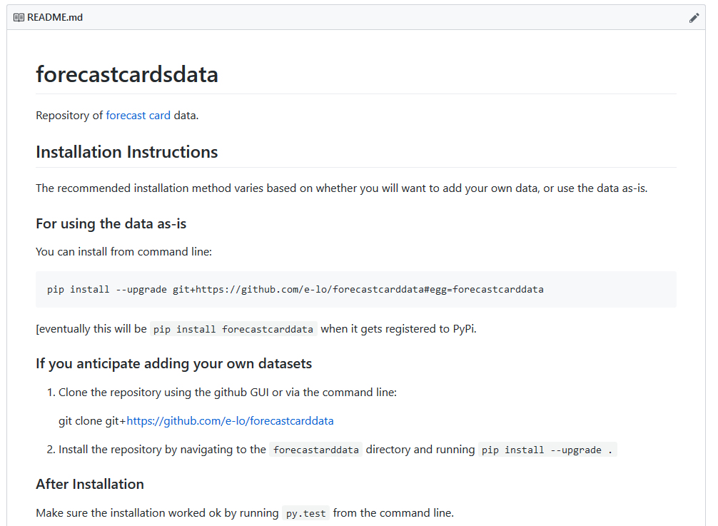
forecastcarddata
https://github.com/gregerhardt/forecastcarddata

Slide 37

Questions & Discussion

Slide 38
Process Conclusions
Some transportation agencies started archiving their forecasts in recent years, and we are beginning to see the benefits.
Inconsistency because agencies used disparate sources of data limited our ability to draw conclusions.
The set of projects for which data are available is not a random sample of projects.

Slide 39
Process Conclusions
Project documentation is often insufficient to evaluate the sources of forecast error.
Evaluation of forecasts is most effective when archived model runs are available.
The best way to compare the accuracy of forecasting methods is by comparing multiple forecasts for the same project.
Don’t discount the value of professional judgment.

